Slide 1

June 2021
AI and Machine Learning @ Apollo Tyres R&D Europe
N. Kostira & E. Verhulp

Slide 2
Welcome
Agenda
Team
Milestones
Background / Problem
Proposed Application of AI
Proposals – Short Term / Internal Projects
Proposals – Long Term / External projects
Next Steps

Slide 3
Advanced Data Analytics (ADA) at R&D
Team
CTO / R&D Head
Chief Digital Officer
Advanced Data Analytics (ADA) Team
End Users and Data Scientist
Claudio Carnale
Data and Data Science
Shailender Gupta
Reporting, Analytics and Data System
Shibu George
Head Advanced Manufacturing
Patrick Goossens
Acting Bus. Partner for R&D
Nik Kostira
ADA Team Coordinator
Eelco Verhulp
ADA Technical Coordinator
Data Engineers
Subject Matter Experts
George de Faria
(Materials/Reinforcements)
Vacant – Depending form the Topic
Alban Hertroys
Peter Schepens
Izaak Boot
Testing
Vacant – Depending form the Topic
Initiated collaboration between ADA R&D and Global IT teams:
With Shailender Gupta on:
Putting LIMS data on AWS Data Lake and using AWS ML libraries/tools (e.g., Sagemaker)
to test ease of development of models and performance of those models in cloud.
With Shibu George on:
Using Cloud Data Lake from connected plant machines (4 / 42 mixers) to predict compound properties with AI
Mathias Vlessert
Vacant – PDEng on FAIR Data repository for Explainable AI
UT Twente (Services, Cybersecurity & Safety)
September Budget is Open for Master Students 1. Twente UNI
Engineering Technology (ET) / Applied Mechanics (AM)*
2. Utrecht University
Algorithms Division - Mathematics and Information Sciences**
*References:
Volkswagen, MechDes Engineering, Airbus
**References:
Dutch Railways, QBuzz, and HERE Technologies, Emotions AI,
https://www.uu.nl/en/research/human-centered-artificial-intelligence/affiliated-projects
Notes:
They will start will connecting 4 mixers.
If all goes well, they will extend to include all 42 mixers

Slide 4
Advanced Data Analytics @ R&D
Milestones
Q3 ‘22
Q2 ’21
Q3 ’21
Q4 ’21
Q1 ’22
Q2 ’22
Q1 ’21
FG
Clean up data continued, start analysis
TBD
Kick Off
Ramp Up
Collect data, start learning and cleaning up data
Get first results
TBD
Core Data Analytics Team Created
Meeting with Global IT, Amazon;
2 Workshops with ALL FLMs
Meeting with Steering Committee
Agree on Problem and start simple with Global IT
Define Internship assignments / Meetings with UNIs
Training on AWS
Testing models in AWS
PDEng student to join in July
Call and present project update to management
Internships Students joining the team
Present first results to Steering Committee
TBD
TBD

Slide 5
Background / Problem
Possible Areas of AI Application:
Design and Development (Tire Construction / Compounds)
Raw materials (Mixing)
Components’ Preparation
Tire Building
Tire Testing (Performances)
Market
Change Management
Chosen Areas/Problems:
Design and Development - Not meeting tire desired performance with desired construction/component/material (SE/NPD)
Change Management - Failing to predict impact of changes on performances and sizes of product line(s) affected by change(s) (CM)
Why problems happen:
NPD/SE – focus is on few development sizes – not always the most performance demanding/most critical sizes of the product line
CM – lack of robust approach to predict critical sizes of the product lines and affected performances*
Impact:
SE – Not-The-First Time Right → Costs of Testing and Validation (+ new Moulds)
CM - Tyre Field Complaints related to changes → Damage on:
Brand Value
Sales opportunity
* For example: SW/Ozon Cracks 727→ 720 in 2016 in all product lines → 727 in Q2 2017; Carcass Separation: cmpd 766 → 767 until 2018 → 766

Slide 6
Proposed Application of AI
Create AI Models in order to get insights on:
Critical Size(s) – most critical, i.e. representative size(s) of the range
Relevant Tests selection – which performance are affected by which (change of) component/material (to be also integrated in Xpert)
Example for RRC: based on development size - predict critical size(s) inside product line and how e.g. number of plies affects RRC
Benefit/Area | New Product Development / Size Extensions | Change Management
Saving time and resources. | (Smart) Choice of Development Sizes | Tests do not need to be performed on non-critical size(s)
 | Anticipate performance drops in Size Extensions | Not all tests have to be performed on critical size
 | Optimize tyre specs directly in Xpert | -
Avoiding Quality Issues on the market. | - | Assure ALL remaining sizes inside the range are meeting performance (PAC, label, etc.) requirements.

Slide 7
Proposals – Short Term / Internal Projects
Product Development / Size Extension and Change Management:
Topic | Goal | Data Available | Feasibility
Rolling Resistance | Predicts RRc for size extension based on development size data and get info on: Critical sizes inside the range Correlation between inputs (e.g. SW, AR, number of plies etc.) and RRC. FEA good alternative. Get familiar with AWS. | Unilab data (incl. PAC) available (~15k) | Moderate/Good
High Speed | Predict HS for size extension based on development size data and get info on critical sizes inside the range. Extend previous exercise and implementing knowledge and tools available at Amazon. | Unilab data (incl. PAC) available (~12k) | Moderate/Good
Tyre dimensions | Predict cured tyre dimensions based on cavity and tyre parameters. FEA accuracy enough? | Unilab data (incl. PAC) available (~9k) | Moderate/Good
Notes:
The following topics didn't come up during the workshop but can, in principle, be analysed, as well:
Footprint: FPS (~1700 datapoints), Ink footprint (~1000 datapoints). The amount of data is limited!
Endurance: Mixed testing: ~7k datapoints. ~4.5k stopped at 16800 km. Perhaps an ok/nok prediction can be made?

Slide 8
Proposals – Long Term / External projects
Product Development in general
Topic | Goal | Data Available | Feasibility
Subjective rating | Use sensor data (steering angle, accelerations, microphone, etc.) to help subjective tyre performance evaluations | Limited. Perhaps useful noise data is available for automatic classification | Short-term: low
Compound and mixing | Mixing data storage in the cloud has started. Further processing to be done (George Shibu from Global IT) | Data collection is starting | Short-term: low
Virtual Compounding | Connect compound (lab) properties with ingredients. Project started with Simreka (George de Faria) | Data available in Interspec and Unilab | Short-term: high
Extrusion | If the virtual compounding project goes well, also mixing and extrusion would come into focus | Not known | Depending on data and external party

Slide 9
Advanced Data Analytics @ R&D
Next Steps
June
Agree on problem to start simple
Import Unilab Data to AWS (with support of IT)
Start with:
Python… – licences free/available and
AWS – After testing using free trial period* costs/budget to be discussed between R&D and Global IT
Knowledge shared between
R&D and
UNIs (students/professors)
July - August
Sharing Internship Assignments to UNIs
PDEng Student starts and introduction program
September - October
Internships Student A (Twente Uni - if budget approved)
Short Updated with CTO/Head R&D
November – December
Internships Student B (Utrecht Uni - if budget approved)
*Amazon SageMaker is free to try. As part of the AWS Free Tier, we can get started with Amazon SageMaker for free for 2 months.

Slide 10

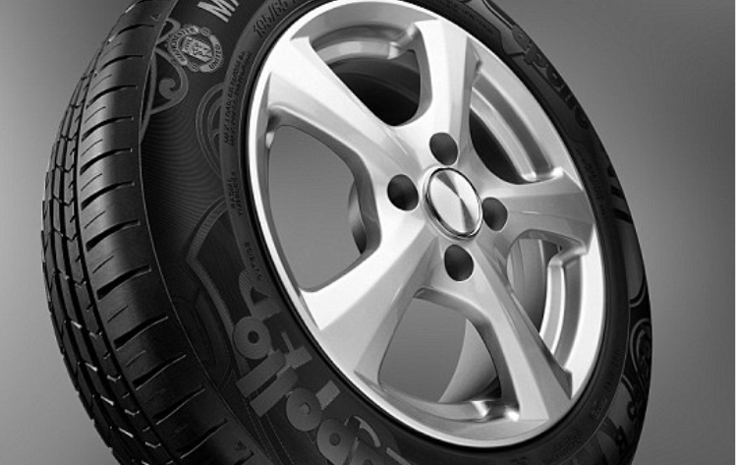
Thank You and Q & A

